Slide 1

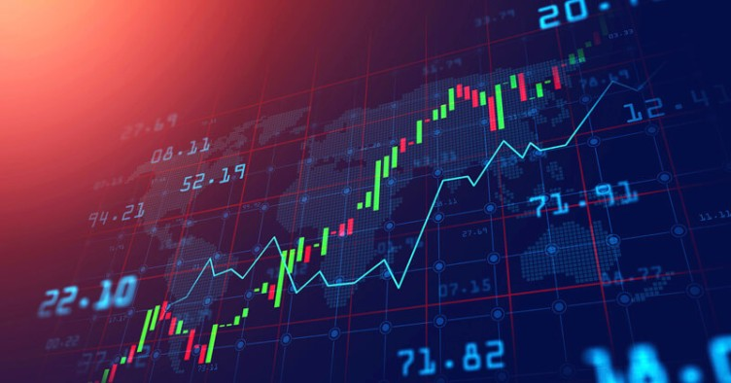
STOCK PRICE PREDICTION
FINAL PROJECT
APPLIED STATISTICS AND DATASCIENCE
JANI SHARIFF SHAIK
YOUSIF ALOUFI

Slide 2
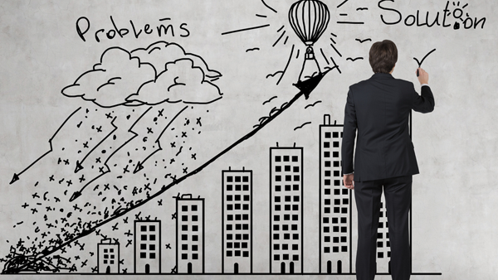
PROBLEM STATEMENT
Apple Inc. is a renowned multinational technology company, and its stock price is influenced by various factors, including market trends, financial performance, global events, and macroeconomic indicators. Accurate prediction of Apple's stock prices is crucial for investors and financial analysts to make informed decisions.
Objective:
The goal of this project is to develop a predictive model that can forecast the future stock prices of Apple Inc. based on historical data and relevant features.

Slide 3

INTRODUCTION
Stocks (Shares):
Stocks represent ownership in a company. When an individual buys shares, they become a partial owner and may benefit from the company's profits through dividends and capital appreciation.
Stock Exchanges:
Stock exchanges are centralized platforms where buyers and sellers come together to trade stocks. Examples include the New York Stock Exchange (NYSE) and the NASDAQ in the United States.

Slide 4

APPROACH
Building a Machine Learning model to predict the stock market price of Apple.inc.

Slide 5
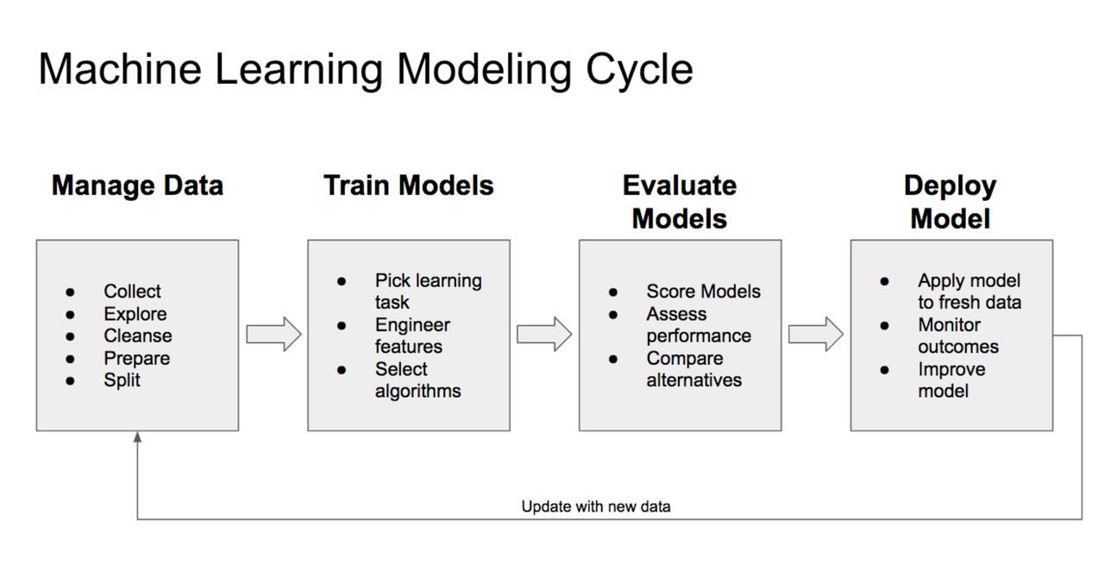
PROCESS

Slide 6

DATA COLLECTION
SOURCE : https://www.kaggle.com/datasets/meetnagadia/apple-stock-price-from-19802021
NAME: Apple Stock price from 1980-2021

Slide 7
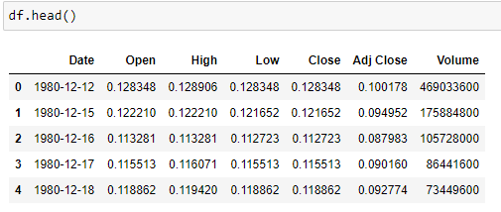
EXPLORATORY DATA ANALYSIS
DATA DESCRIPTION
Date: The date on which the stock market data was recorded.
Open: The opening price of Apple stock at the beginning of the trading day.
High: The highest price reached by Apple stock during the trading day.
Low: The lowest price reached by Apple stock during the trading day.
Close: The closing price of Apple stock at the end of the trading day.
Adj Close: The closing price adjusted for factors such as dividends, stock splits, and other corporate actions.
Volume: The number of shares traded during the trading day. and sellers come together to trade stocks. Examples include the New York Stock Exchange (NYSE) and the NASDAQ in the United States.

Slide 8
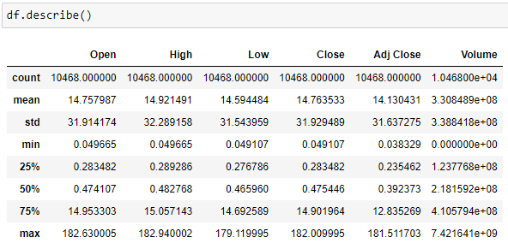
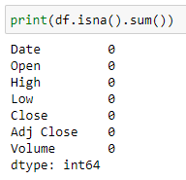
EXPLORATORY DATA ANALYSIS
Descriptive statistics

Slide 9
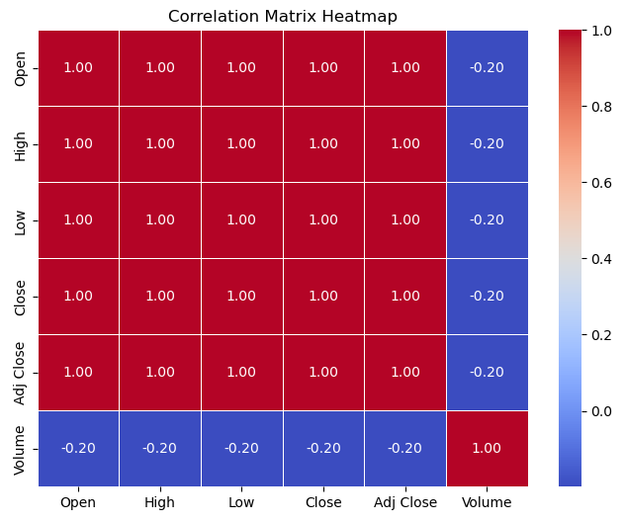
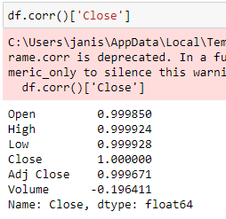
EXPLORATORY DATA ANALYSIS

Slide 10
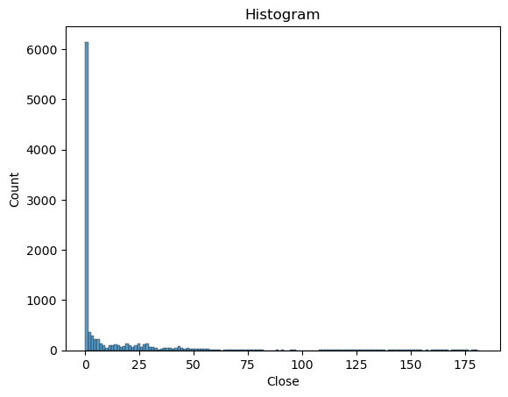
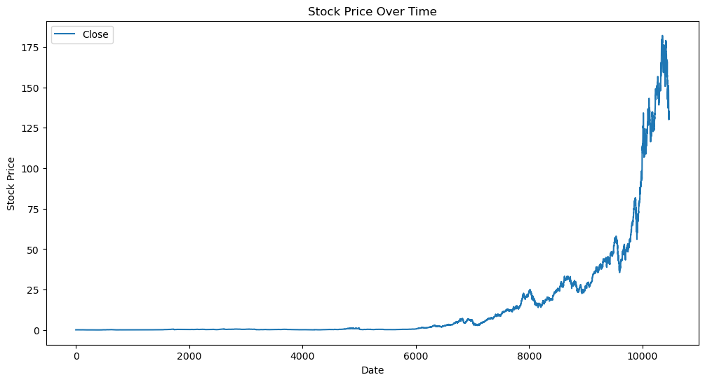
EXPLORATORY DATA ANALYSIS
Data Visualization
Closing Price of The Stock over Years

Slide 11
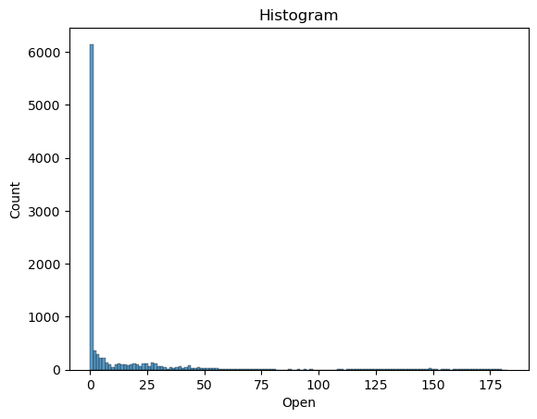
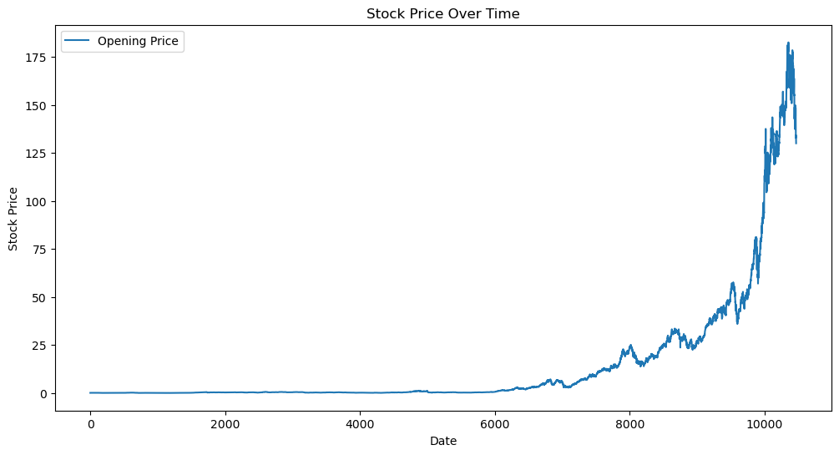
EXPLORATORY DATA ANALYSIS
Opening Price of The Stock over Years

Slide 12
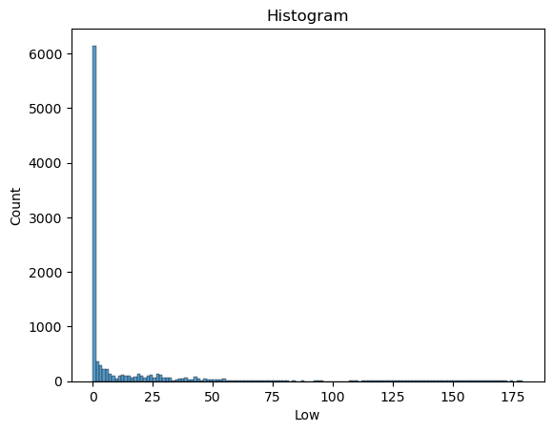
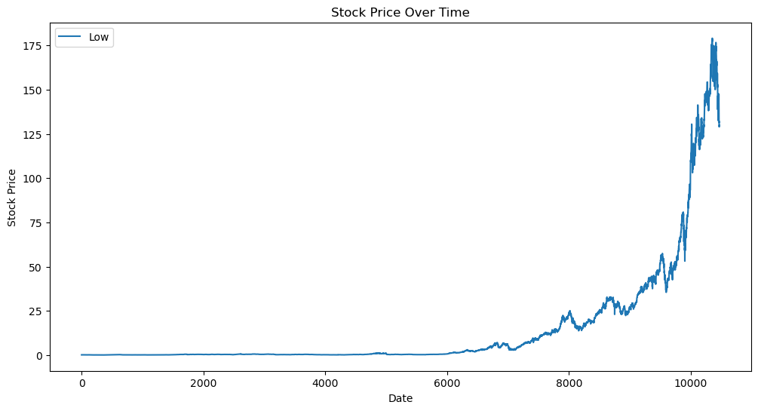
EXPLORATORY DATA ANALYSIS
Low-Price on the respective day of the stock over years

Slide 13

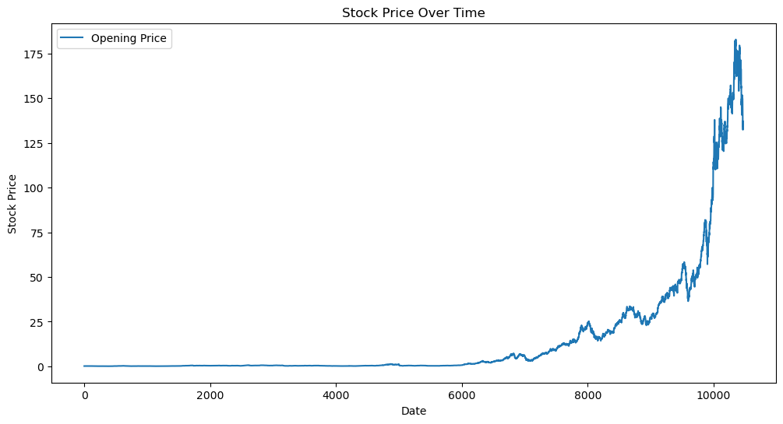
EXPLORATORY DATA ANALYSIS
High-Price on the respective day of The Stock over Years

Slide 14
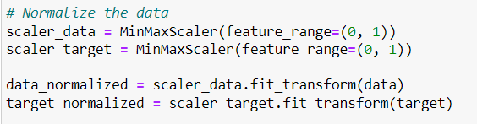

EXPLORATORY DATA ANALYSIS
Normalization of Data
MinMaxScaler is a feature scaling technique used in machine learning to normalize the range of numerical features or variables.

Slide 15
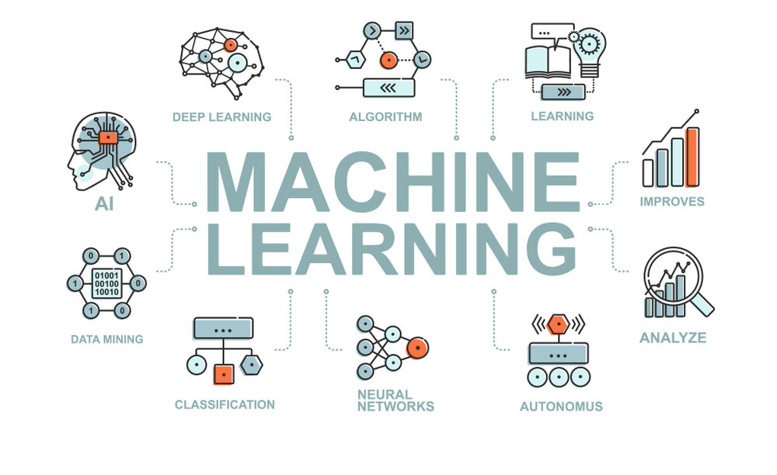

Slide 16
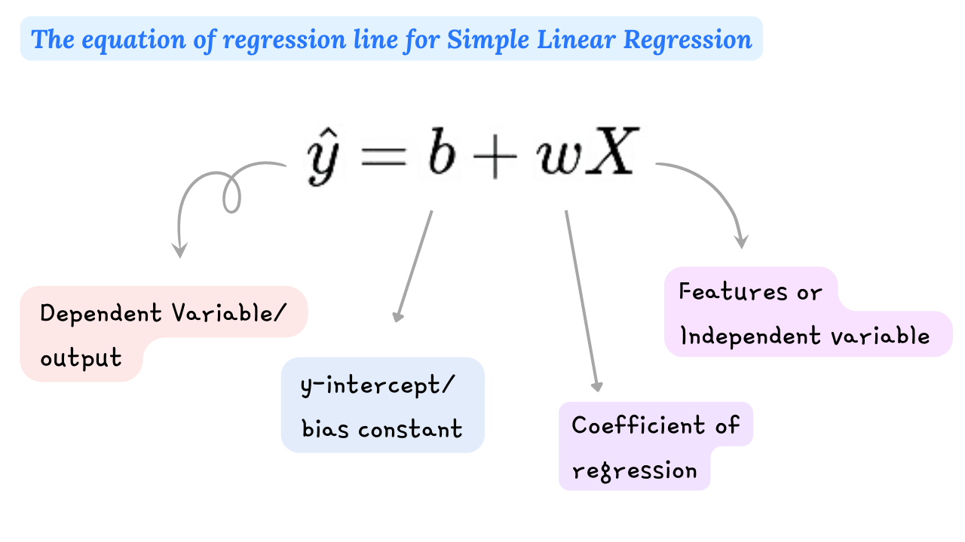
LINEAR REGRESSION
Linear Regression Machine Learning Algorithm Linear Regression is a supervised machine learning algorithm used for predicting a continuous outcome variable (also called the dependent variable) based on one or more predictor variables (independent variables).

Slide 17
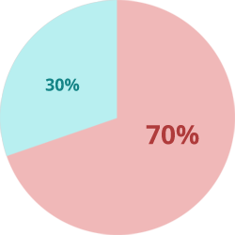
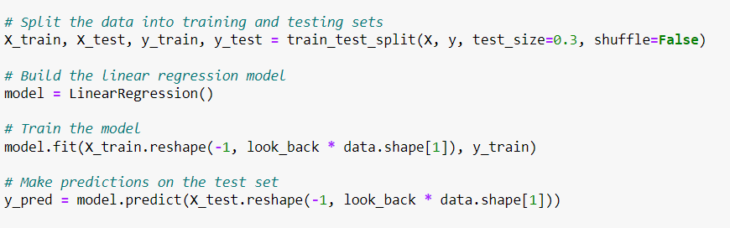
LINEAR REGRESSION
Building a Machine Learning Model
Train-Test Split
Building the Model

Slide 18

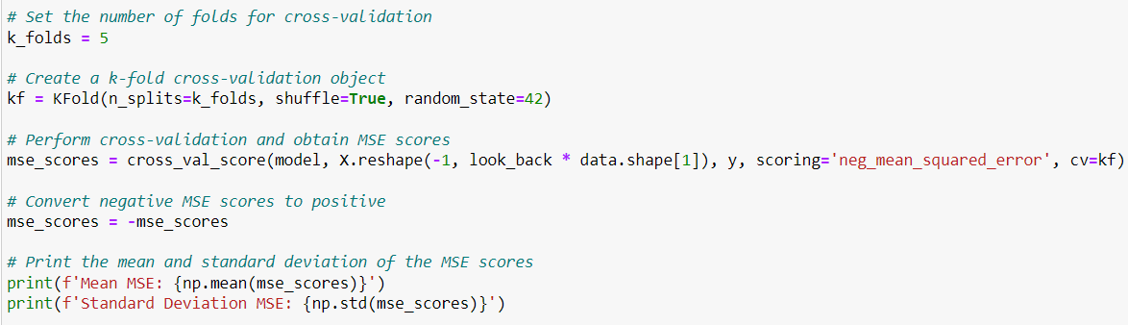
LINEAR REGRESSION
Evaluating the model with Cross-Validation
Cross-validation is a statistical technique used to assess the performance and generalization capability of a machine learning model. It involves partitioning the dataset into multiple subsets, training the model on some of these subsets, and evaluating it on the remaining subsets.
Technique Used : K-Fold Cross-Validation
K-Fold Cross-Validation is a commonly used technique where the dataset is divided into k subsets (folds).The model is trained and evaluated k times, each time using a different fold as the test set and the remaining folds as the training set.

Slide 19
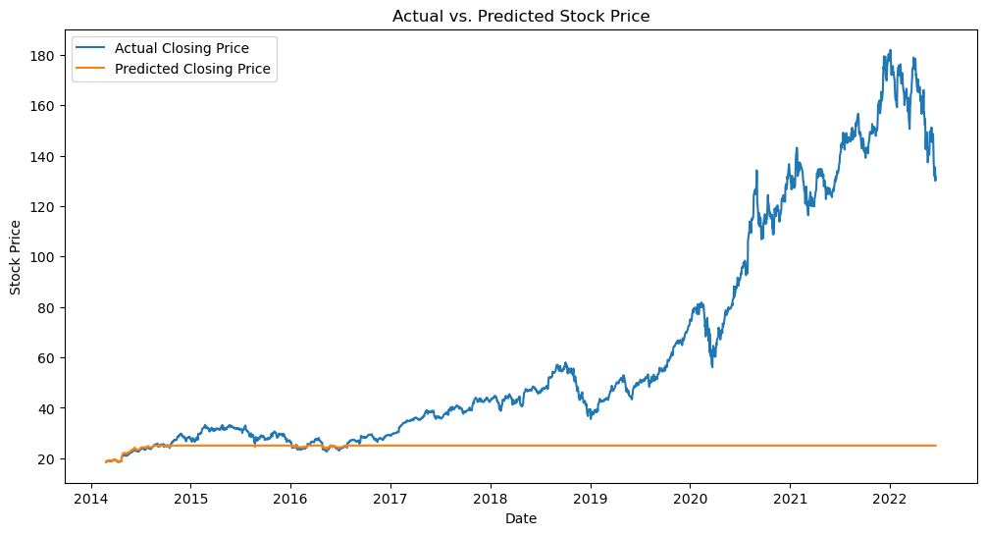
LINEAR REGRESSION
Actual Values v/s Prediction Values Graph

Slide 20
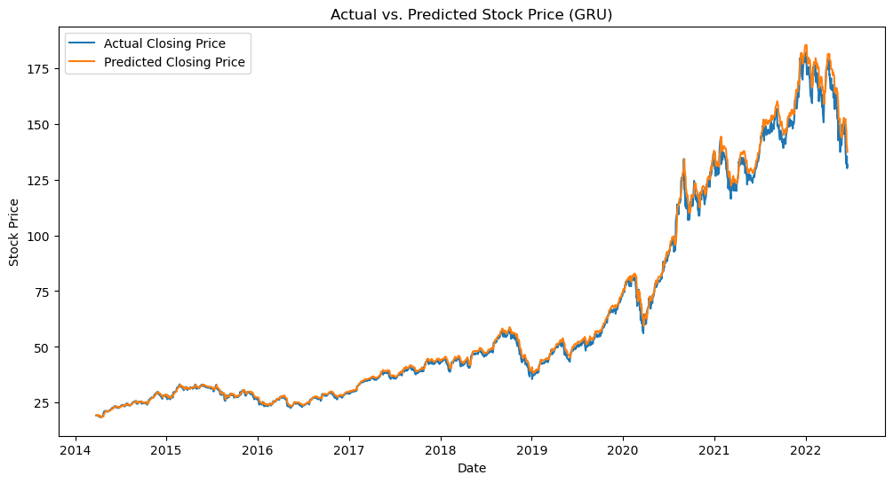

LINEAR REGRESSION
Actual Values v/s Prediction Values Graph

Slide 21


Slide 22

JANI SHARIFF SHAIK
YOUSIF SAEED ALOUFI

